Slide 1
LIGHTS
RATINGS
ACTION
RUCHIKA GOGIA
LEWIS CLARK
SANTIAGO LARREA
GABY VELÁSQUEZ

Slide 2
INTRODUCTION
DATASET:
IMDb movies, videogames and tv shows (115,988 titles, 28 genres, 39,519 directors, 197,864 stars)
TOOLS:
MySQL, Pandas, SQLAlchemy, Matplotlib
GOAL:
Explore patterns in ratings, genres, and director performance for all playable video works such as movies, video games, series, or TV shows on IMDB

Slide 3
HYPOTHESIS
DIRECTORS
01
Aug 2025
Top 10 directors by rating
GENRES (A)
02
Aug 2025
Top 10 genres by rating
GENRES (B)
03
Aug 2025
Top 10 genres by number of titles
CERTIFICATE
04
Aug 2025
Average rating by certificate

Slide 4
DATA CLEANING AND NORMALISATION
01
02
03
04
Data Inspection
Standardisation
Review dataset to identify missing, inconsistent, or duplicate values.
Ensure consistent formats (e.g., remove " min" from runtime, strip commas from votes, unify text case).
Validation
Normalisation
Remove duplicates (df.drop_duplicates()), filter out rows with missing runtime or votes, and fix invalid list entries.
Split data into relational tables for SQL (e.g., one table for movies, one for genres linke, etc).

Slide 5
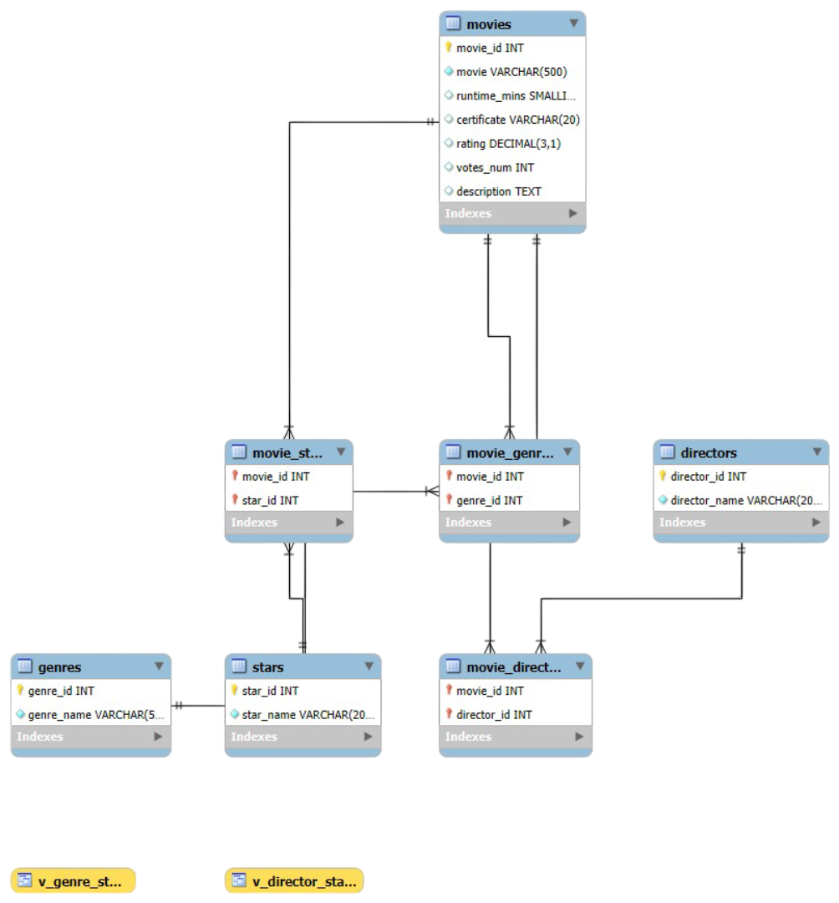
ERD
7 interconnected tables
Foreign keys to maintain relationships
Python + Pandas → MySQL
directors genres stars
| | |
| | |
movie_directors movie_genres movie_stars
\ | /
\ | /
movies

Slide 6
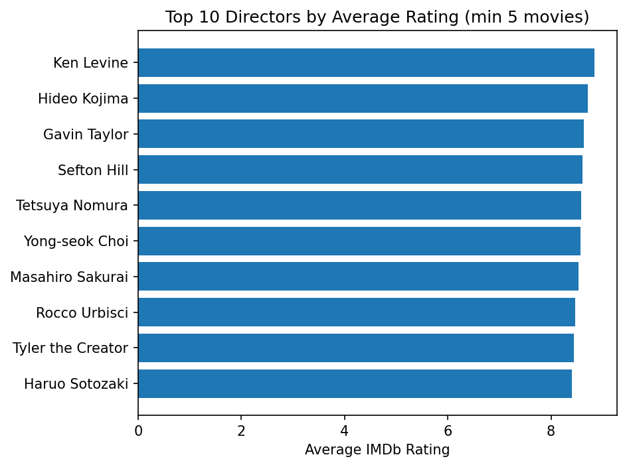
HYPOTHESIS: DIRECTORS
As we can see consistently high-rated directors significantly influence IMDb ratings through style and reputation.

Slide 7
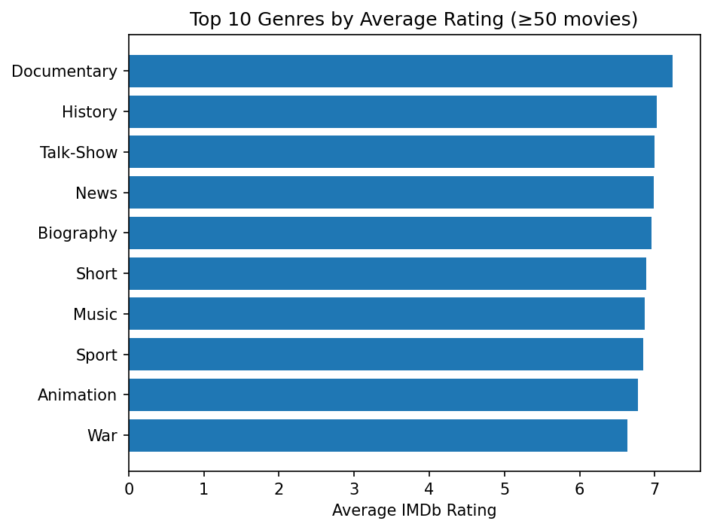
HYPOTHESIS: GENRES BY RATING (A)
Certain genres, such as Documentary and History, consistently achieve higher IMDb ratings due to their informative and impactful content.

Slide 8
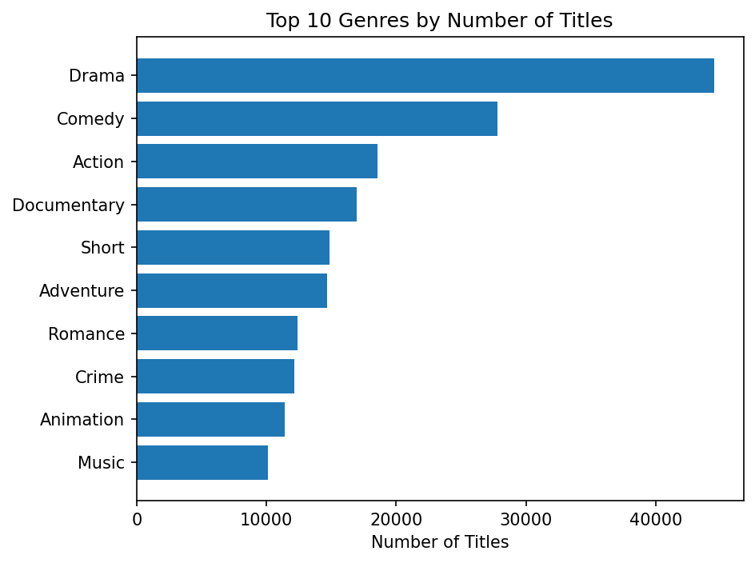
HYPOTHESIS: GENRES BY TITLES (B)
Drama and Comedy dominate film production, reflecting audience demand and industry focus on widely appealing genres.

Slide 9
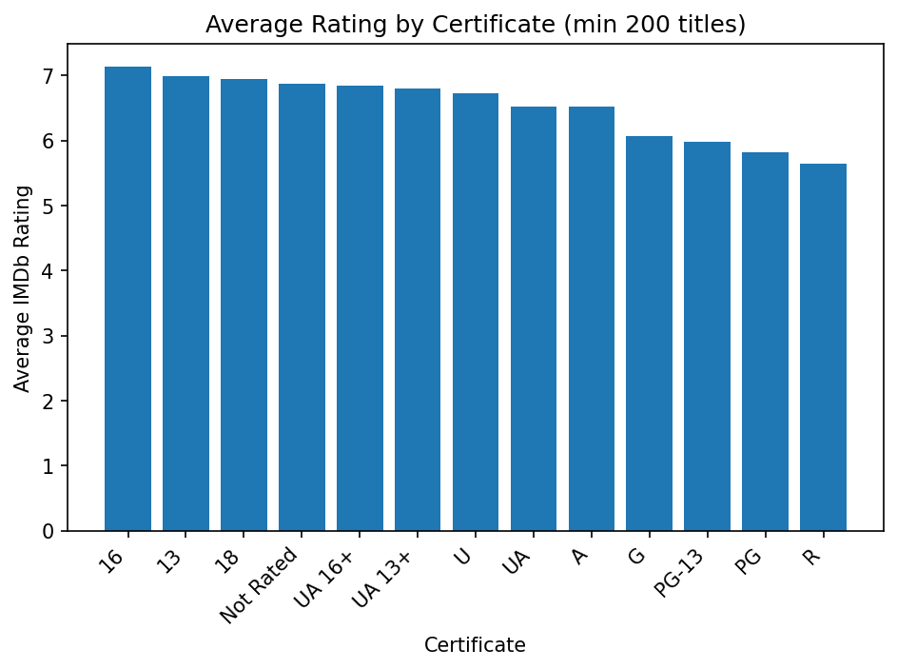
HYPOTHESIS: RATING BY CERTIFICATE
Average ratings are highest for 16, 13 and 18 categories. Indicating that audiences want slightly more mature content. However, PG and R were the lowest rating revealing that audiences don’t favour the extremes

Slide 10
Conclusions & Business Implications
Hypothesis partially supported:
Yes → Some directors/genres are consistently high-rated
Yes → Genre popularity has shifted significantly
No → Certificates did not strongly influence ratings except for extreme cases
Practical use — Studios can:
Focus investment on trending genres
Pair strong directors with high-demand genres
Target certificate ratings strategically

Slide 11
MAJOR OBSTACLES
Loading the main CSV into MySQL Workbench.
Initial attempts failed — data didn’t appear in our target tables.
Additional components were installed via PowerShell to ensure compatibility with MySQL Workbench.
WHAT WE LEARNED FROM OBSTACLES
Resilience — research alternative tools & workflows to solve technical blocks.

Slide 12
THANKS!
RUCHIKA GOGIA
LEWIS CLARK
SANTIAGO LARREA
GABY VELÁSQUEZ
LIGHTS RATINGS ACTION!

